Slide 1
The Interaction

Slide 2
What is interaction?
communication
user system

Slide 3
Some terms of interaction
domain – the area of work under study
e.g. graphic design
goal – what you want to achieve
e.g. create a solid red triangle
task – how you go about doing it – ultimately in terms of operations or actions
e.g. … select fill tool, click over triangle

Slide 4
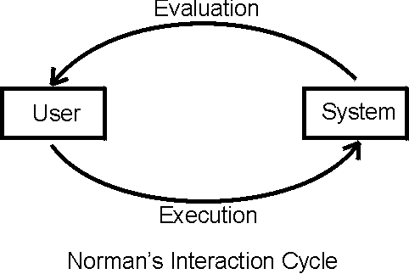
Donald Norman’s model
Seven stages
user establishes the goal
formulates intention
specifies actions at interface
executes action
perceives system state
interprets system state
evaluates system state with respect to goal
Norman’s model concentrates on user’s view of the interface

Slide 5
execution/evaluation loop
goal
execution
evaluation
user establishes the goal
formulates intention
specifies actions at interface
executes action
perceives system state
interprets system state
evaluates system state with respect to goal
system

Slide 6
execution/evaluation loop
goal
user establishes the goal
formulates intention
specifies actions at interface
executes action
perceives system state
interprets system state
evaluates system state with respect to goal
execution
evaluation
system

Slide 7
execution/evaluation loop
goal
user establishes the goal
formulates intention
specifies actions at interface
executes action
perceives system state
interprets system state
evaluates system state with respect to goal
execution
evaluation
system

Slide 8
execution/evaluation loop
goal
user establishes the goal
formulates intention
specifies actions at interface
executes action
perceives system state
interprets system state
evaluates system state with respect to goal
execution
evaluation
system

Slide 9
Using Norman’s model
Some systems are harder to use than others
Gulf of Execution
user’s formulation of actions ≠ actions allowed by the system
Gulf of Evaluation
user’s expectation of changed system state ≠ actual presentation of this state

Slide 10
Gulf of execution
The gulf of execution is the degree to which the interaction possibilities of an artifact, a computer system or likewise correspond to the intentions of the person and what that person perceives is possible to do with the artifact/application/etc.
Example
a person can look at a light switch and easily tell what the current state of the system is (i.e., whether the light is on or off) and how to operate the switch. This means that the gulf of execution is small.

Slide 11
Gulf of Evaluation
The gulf of evaluation is the degree to which the system/artifact provide representations that can be directly perceived and interpreted in terms of the expectations and intentions of the user (Norman 1988).
An example of a large gulf of evaluation is when an application has a spinning wheel to show a “loading” state after the user performs an action. The wheel alone is not enough for the user to interpret the progress that the system is making in response to their action.

Slide 12
Human error - slips and mistakes
slip
understand system and goal
correct formulation of action
incorrect action
mistake
may not even have right goal!
Fixing things?
slip – better interface design
mistake – better understanding of system

Slide 13
Abowd and Beale framework
extension of Norman…
their interaction framework has 4 parts
user
input
system
output
each has its own unique language interaction ⇒ translation between languages
problems in interaction = problems in translation
O
output
S
core
U
task
I
input

Slide 14
Using Abowd & Beale’s model
user intentions → translated into actions at the interface → translated into alterations of system state → reflected in the output display → interpreted by the user
general framework for understanding interaction
not restricted to electronic computer systems
identifies all major components involved in interaction
allows comparative assessment of systems
an abstraction

Slide 15
Interactive Cycle
Interface
System
User
Core
Presentation
Observation
Output
Input
Task
Articulation
Performance
[Dix]

Slide 16
Translations Between Components
articulation
user translates task intentions into the input language
performance
input language is translated into stimuli for the system
presentation
system activities are translated into output language
observation
output language is translated into the user’s task model

Slide 17
Example: Light in a Room
controlling the lighting in a room
task language: turn lights on/off
input language: flip switch
system language: close/open circuit for light bulbs
output language: lights on/off

Slide 18
Example (cont)
translations
articulation
user decides to turn on the light, and flips a switch
performance
flipped switch closes the circuit
presentation
light bulb emits light
observation
user notices that the light is on
frequent problem
multiple switches in large rooms

Slide 19
Practical Exercise
Describe the languages and translations for the interactions required to open a document containing the third homework for this class.

Slide 20
Practical Exercise: Open a Document
languages
task language: activities described in natural language
input language: user commands, file names
system language: system calls, OS objects
output language: commands for an output device
e.g. screen, or PostScript for a printer

Slide 21
Practical Exercise: Digital vs. Analog Clocks
Describe and compare the languages and translations used for setting digital and analog clocks. What are frequent problems with the two device types and their languages or translations?
languages
task language: set time to a certain value
input language: wheel vs. buttons
system language: mechanical movement vs. ICs
output language: minute and hour hands vs. LCD display

Slide 22
Practical Exercise (cont.)
translations
articulation
turn wheel / press buttons
performance
clock translates input actions into modified display
presentation
new time setting is displayed
observation
user translates hand positions or numbers into time

Slide 23
Practical Exercise (cont.)
problems
which way do you turn the wheel
which button do you press, how often, in which combination
turning the time “back” on a digital clock is frequently impossible

Slide 24
Ergonomics
Study of the physical characteristics of interaction
Also known as human factors – but this can also be used to mean much of HCI!
Ergonomics good at defining standards and guidelines for constraining the way we design certain aspects of systems

Slide 25
Ergonomics - examples
arrangement of controls and displays
e.g. controls grouped according to function or frequency of use, or sequentially
surrounding environment
e.g. seating arrangements adaptable to cope with all sizes of user
health issues
e.g. physical position, environmental conditions (temperature, humidity), lighting, noise,
use of colour
e.g. use of red for warning, green for okay, awareness of colour-blindness etc.

Slide 26
Common interaction styles
command line interface
menus
natural language
question/answer and query dialogue
form-fills and spreadsheets
WIMP
point and click
three–dimensional interfaces

Slide 27
Speech–driven interfaces
rapidly improving … … but still inaccurate
how to have robust dialogue? … interaction of course!
can’t always avoid errors … … but we can put them right
make it easy to detect errors … then the user can repair them

Slide 28
Physical design
many constraints:
ergonomic – minimum button size
physical – high-voltage switches are big
legal and safety – high cooker controls
context and environment – easy to clean
aesthetic – must look good
economic – … and not cost too much!

Slide 29
Fluidity
do external physical aspects reflect logical effect?
related to affordance
logical state revealed in physical state?
e.g. on/off buttons
inverse actions inverse effects?
e.g. arrow buttons, twist controls

Slide 30
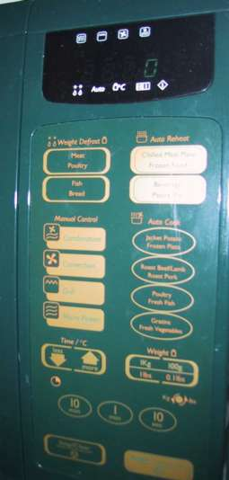
physical layout
controls:
logical relationship ~ spatial grouping

Slide 31
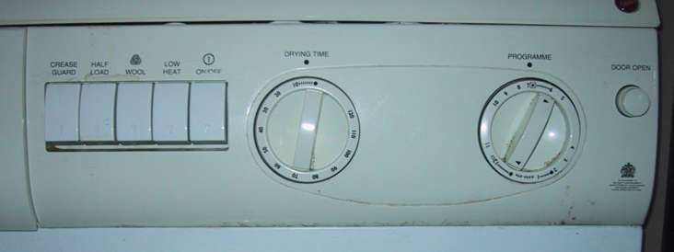
compliant interaction
state evident in mechanical buttons
rotary knobs reveal internal state and can be controlled by both user and machine

Slide 32
General lesson …
if you want someone to do something …
make it easy for them!
understand their values

